Slide 1
1.9 IoT Design Methodology
Outline:
IoT Design Methodology includes:
Purpose & Requirements Specification
Process Specification
Domain Model Specification
Information Model Specification
Service Specifications
IoT Level Specification
Functional View Specification
Operational View Specification
Device & Component Integration
Application Development

Slide 2
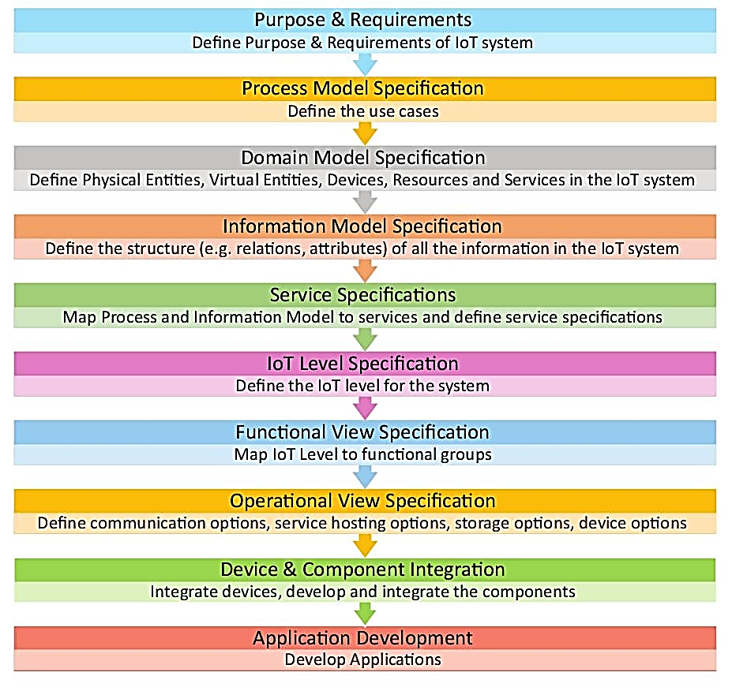
1.9 IoT Design Methodology

Slide 3
1.9 IoT Design Methodology
Step 1: Purpose & Requirements Specification
The first step in IoT system design methodology is to define the purpose and requirements of the system.
In this step, the system purpose, behavior and requirements (such as data collection requirements, data analysis requirements, system management requirements, data privacy and security requirements, user interface requirements, ...) are captured.

Slide 4
Step 2: Process Specification
The second step in the IoT design methodology is to define the process specification. In this step, the use cases of the IoT system are formally described based on and derived from the purpose and requirement specifications.

Slide 5
Step 3: Domain Model Specification
The third step in the IoT design methodology is to define the Domain Model. The domain model describes the main concepts, entities and objects in the domain of IoT system to be designed. Domain model defines the attributes of the objects and relationships between objects. Domain model provides an abstract representation of the concepts, objects and entities in the IoT domain, independent of any specific technology or platform. With the domain model, the IoT system designers can get an understanding of the IoT domain for which the system is to be designed.

Slide 6
Step 4: Information Model Specification
The fourth step in the IoT design methodology is to define the Information Model. Information Model defines the structure of all the information in the IoT system, for example, attributes of Virtual Entities, relations, etc. Information model does not describe the specifics of how the information is represented or stored. To define the information model, we first list the Virtual Entities defined in the Domain Model. Information model adds more details to the Virtual Entities by defining their attributes and relations.

Slide 7
Step 5: Service Specifications
The fifth step in the IoT design methodology is to define the service specifications. Service specifications define the services in the IoT system, service types, service inputs/output, service endpoints, service schedules, service preconditions and service effects.

Slide 8
Step 6: IoT Level Specification
The sixth step in the IoT design methodology is to define the IoT level for the system. In Chapter-1, we defined five IoT deployment levels.

Slide 9
Step 7: Functional View Specification
The seventh step in the IoT design methodology is to define the Functional View. The Functional View (FV) defines the functions of the IoT systems grouped into various Functional Groups (FGs). Each Functional Group either provides functionalities for interacting with instances of concepts defined in the Domain Model or provides information related to these concepts.

Slide 10
Step 8: Operational View Specification
The eighth step in the IoT design methodology is to define the Operational View Specifications. In this step, various options pertaining to the IoT system deployment and operation are defined, such as, service hosting options, storage options, device options, application hosting options, etc

Slide 11
Step 9: Device & Component Integration
The ninth step in the IoT design methodology is the integration of the devices and components.

Slide 12
Step 10: Application Development
The final step in the IoT design methodology is to develop the IoT application.

Slide 13
Home Automation Case Study

Slide 14
Step:1 - Purpose & Requirements
Applying this to our example of a smart home automation system, the purpose and requirements for the system may be described as follows:
Purpose : A home automation system that allows controlling of the lights in a home remotely using a web application.
Behavior : The home automation system should have auto and manual modes. In auto mode, the system measures the light level in the room and switches on the light when it gets dark. In manual mode, the system provides the option of manually and remotely switching on/off the light.
System Management Requirement : The system should provide remote monitoring and control functions.
Data Analysis Requirement : The system should perform local analysis of the data.
Application Deployment Requirement : The application should be deployed locally on the device, but should be accessible remotely.
Security Requirement : The system should have basic user authentication capability.

Slide 15
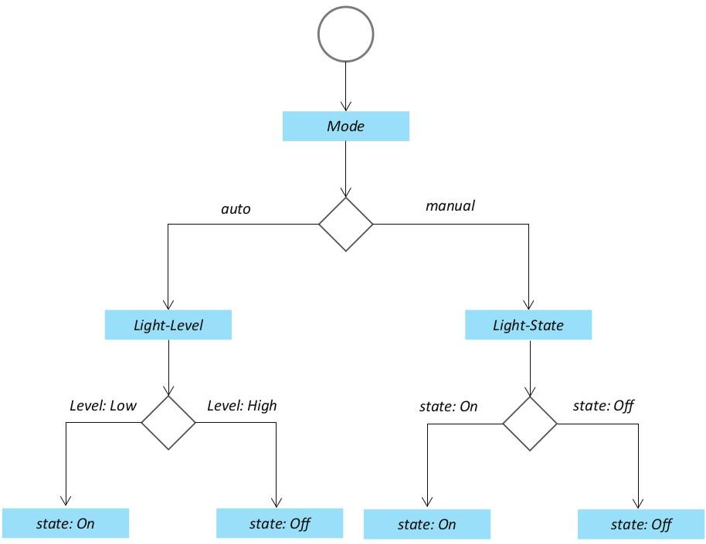
Step:2 - Process Specification

Slide 16
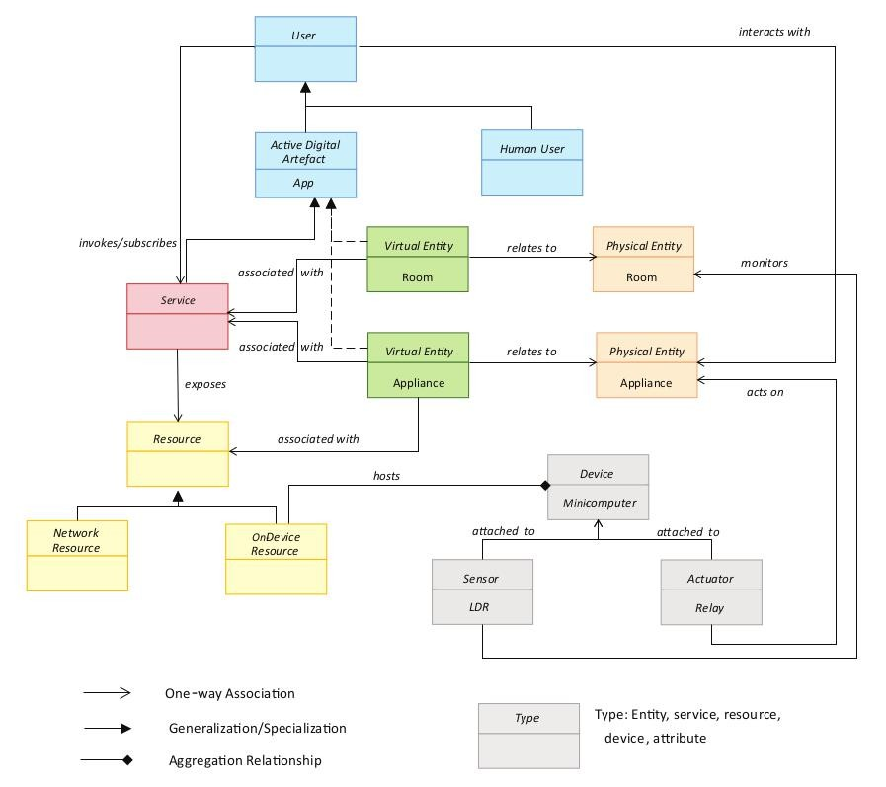
Step 3: Domain Model Specification

Slide 17
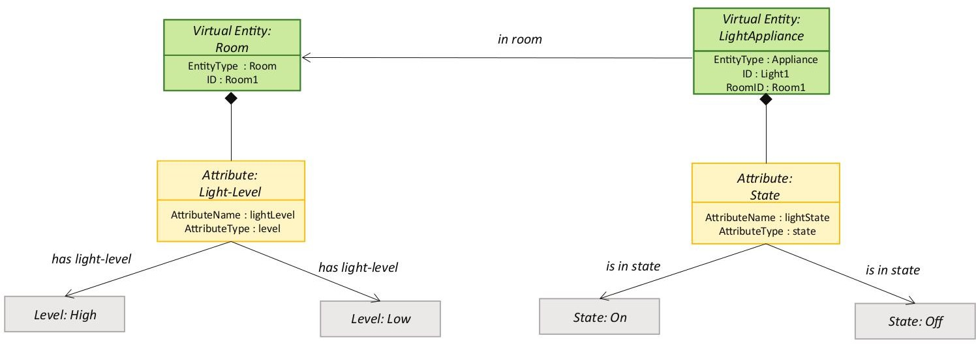
Step 4: Information Model Specification

Slide 18
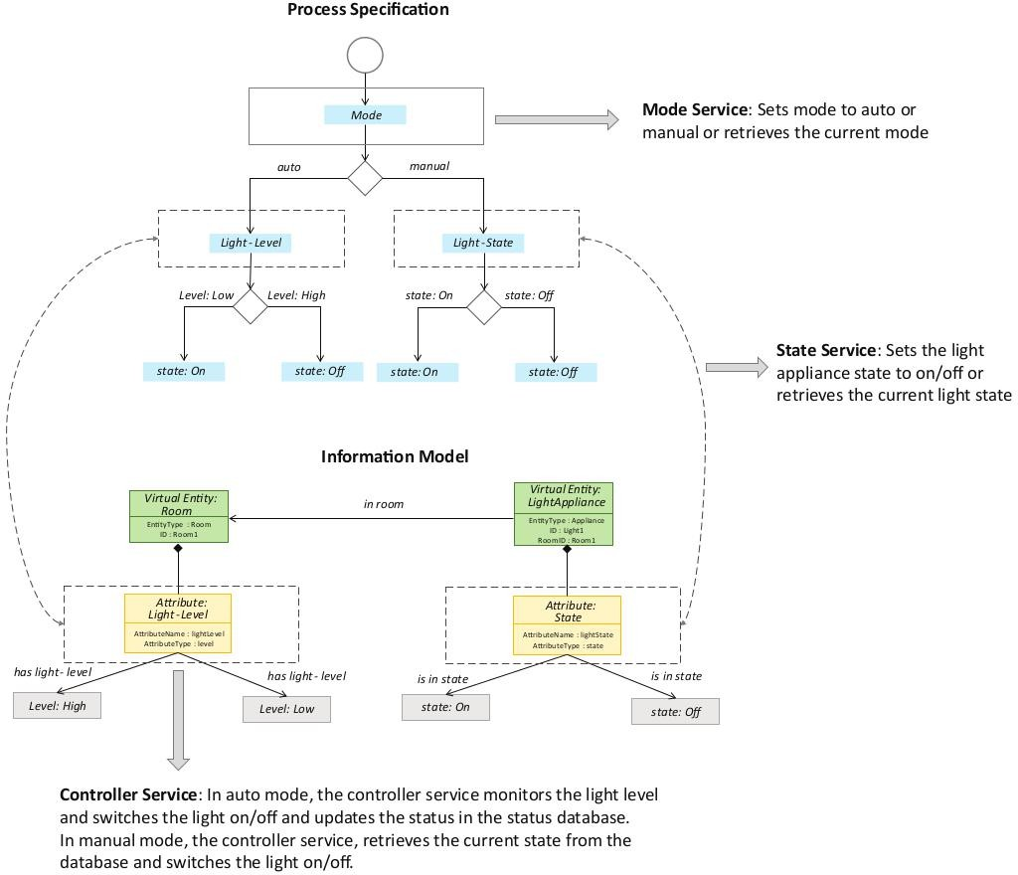
Step 5: Service Specifications

Slide 19
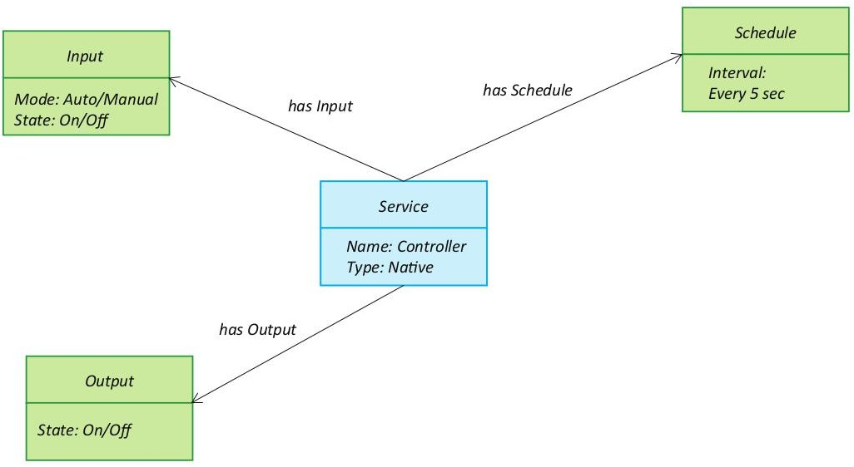
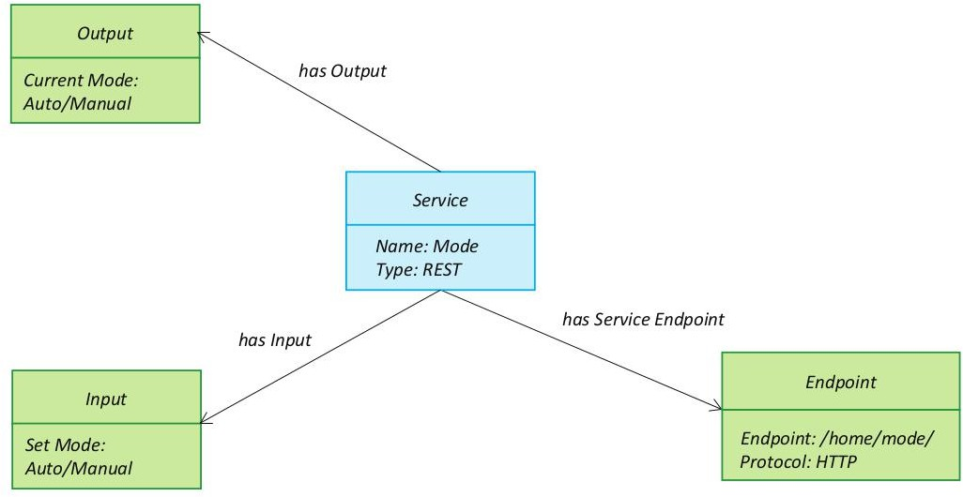
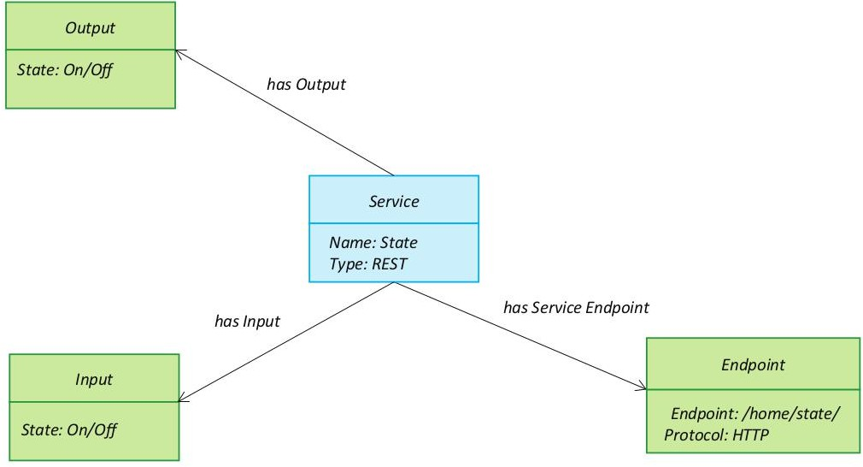
Step 5: Service Specifications

Slide 20
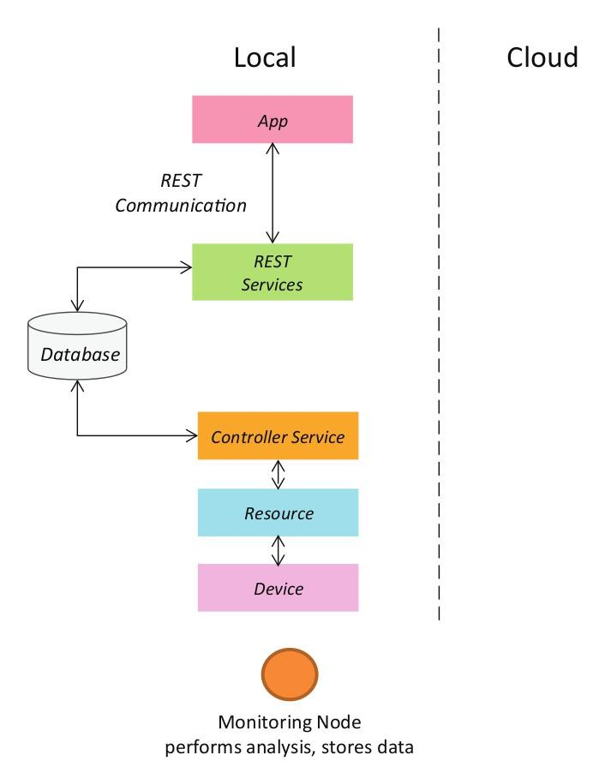
Step 6: IoT Level Specification

Slide 21
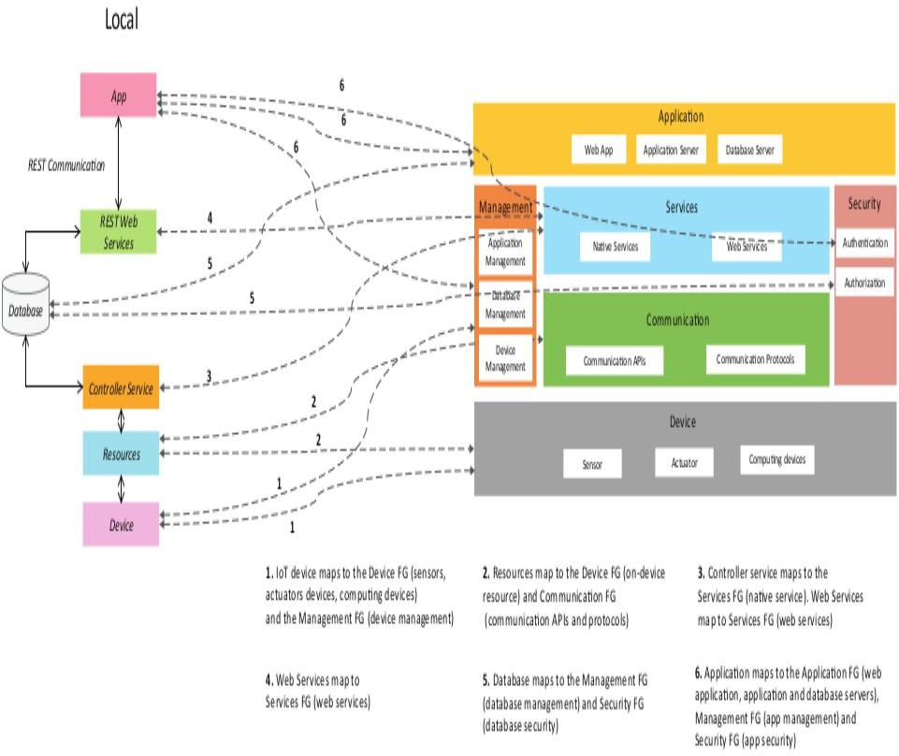
Step 7: Functional View Specification

Slide 22
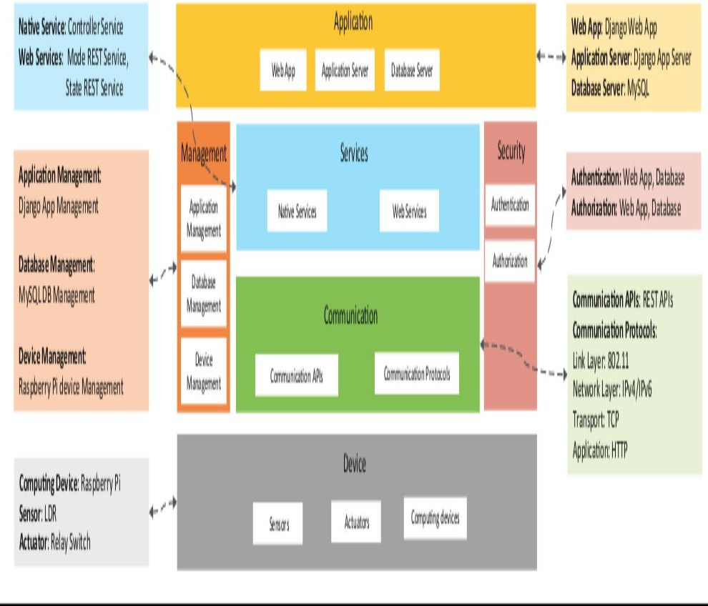
Step 8: Operational View Specification

Slide 23
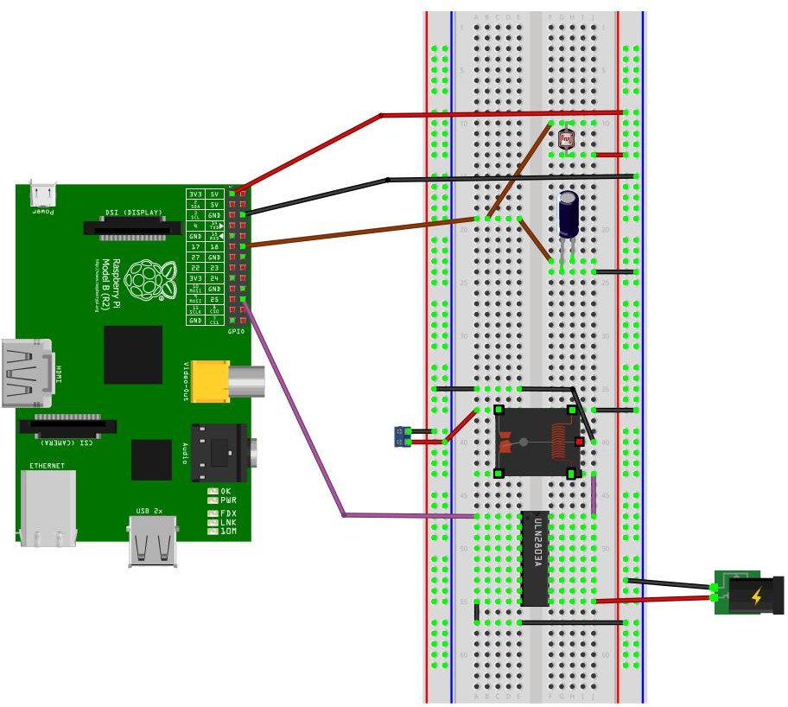
Step 9: Device & Component Integration

Slide 24
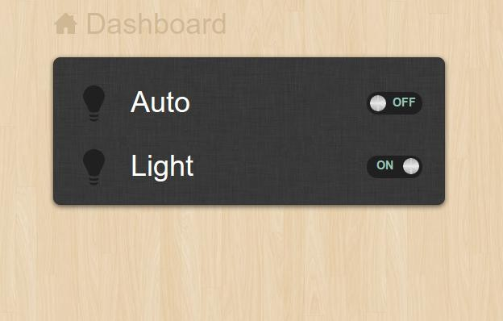
Step 10: Application Development
Auto
Controls the light appliance automatically based on the lighting conditions in the room
Light
When Auto mode is off, it is used for manually controlling the light appliance.
When Auto mode is on, it reflects the current state of the light appliance.

Slide 25
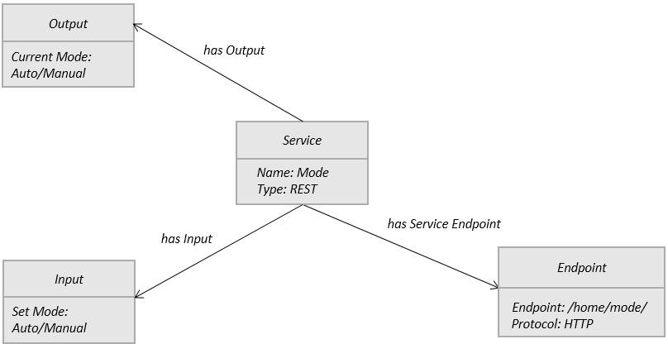
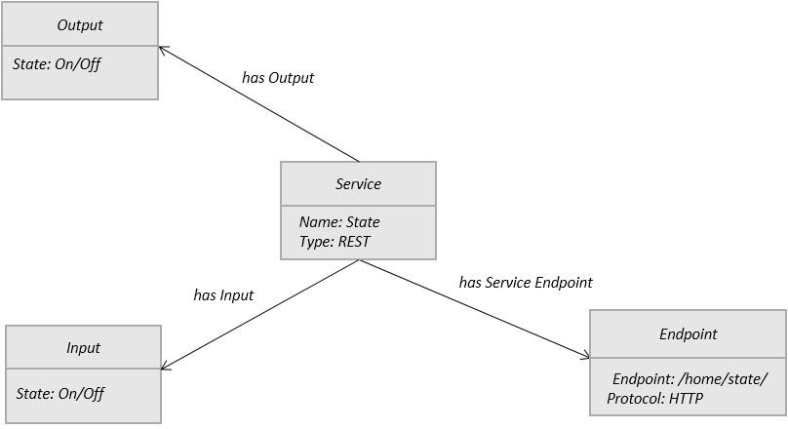
Implementation: RESTful Web Services
REST services implemented with Django REST Framework
# Models – models.py
from django.db import models
class Mode(models.Model):
name = models.CharField(max_length=50)
class State(models.Model):
name = models.CharField(max_length=50)
1. Map services to models. Model fields store the states (on/off, auto/manual)
2. Write Model serializers. Serializers allow complex data (such as model instances) to be converted to native Python datatypes that can then be easily rendered into JSON, XML or other content types.
# Serializers – serializers.py
from myapp.models import Mode, State from rest_framework import serializers
class ModeSerializer(serializers.HyperlinkedModelSerializer): class Meta:
model = Mode
fields = ('url', 'name')
class StateSerializer(serializers.HyperlinkedModelSerializer): class Meta:
model = State
fields = ('url', 'name')

Slide 26
Implementation: RESTful Web Services
# Views – views.py
from myapp.models import Mode, State from rest_framework import viewsets
from myapp.serializers import ModeSerializer, StateSerializer
class ModeViewSet(viewsets.ModelViewSet): queryset = Mode.objects.all() serializer_class = ModeSerializer
class StateViewSet(viewsets.ModelViewSet): queryset = State.objects.all() serializer_class = StateSerializer
# Models – models.py
from django.db import models
class Mode(models.Model):
name = models.CharField(max_length=50)
class State(models.Model):
name = models.CharField(max_length=50)
3. Write ViewSets for the Models which combine the logic for a set of related views in a single class.
# URL Patterns – urls.py
from django.conf.urls import patterns, include, url from django.contrib import admin
from rest_framework import routers from myapp import views admin.autodiscover()
router = routers.DefaultRouter() router.register(r'mode', views.ModeViewSet) router.register(r'state', views.StateViewSet) urlpatterns = patterns('',
url(r'^', include(router.urls)),
url(r'^api-auth/', include('rest_framework.urls', namespace='rest_framework')), url(r'^admin/', include(admin.site.urls)),
url(r'^home/', 'myapp.views.home'),
)
4. Write URL patterns for the services.
Since ViewSets are used instead of views, we can automatically generate the URL conf by simply registering the viewsets with a router class.
Routers automatically determining how the URLs for an application should be mapped to the logic that deals with handling incoming requests.

Slide 27
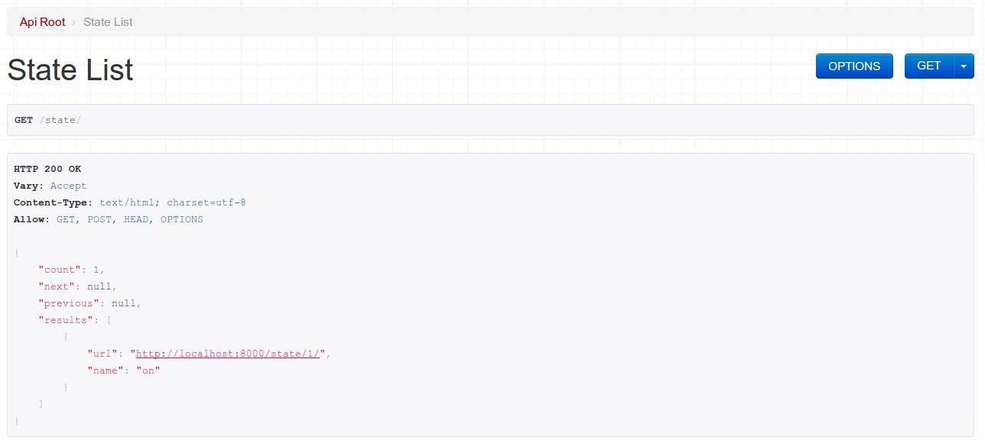
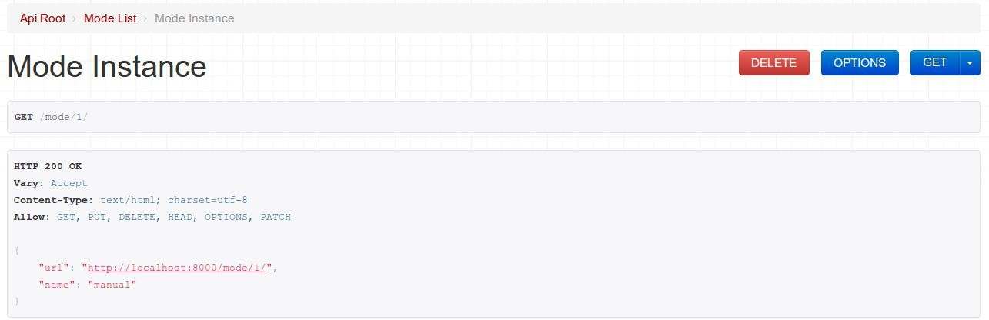
Implementation: RESTful Web Services
Screenshot of browsable State REST API
Screenshot of browsable Mode REST API

Slide 28
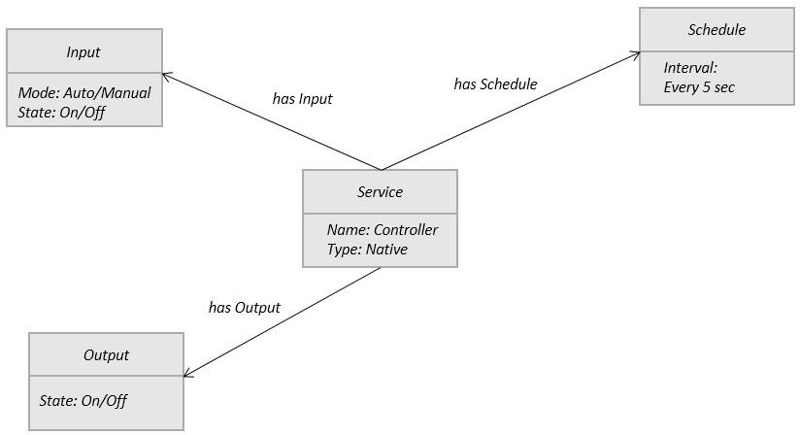
Implementation: Controller Native Service
#Controller service import RPi.GPIO as GPIO import time
import sqlite3 as lite import sys
con = lite.connect('database.sqlite') cur = con.cursor()
GPIO.setmode(GPIO.BCM) threshold = 1000
LDR_PIN = 18
LIGHT_PIN = 25
def readldr(PIN):
reading=0
GPIO.setup(PIN, GPIO.OUT) GPIO.output(PIN, GPIO.LOW)
time.sleep(0.1) GPIO.setup(PIN, GPIO.IN)
while (GPIO.input(PIN)==GPIO.LOW): reading=reading+1
return reading
def switchOnLight(PIN):
GPIO.setup(PIN, GPIO.OUT) GPIO.output(PIN, GPIO.HIGH)
def switchOffLight(PIN):
GPIO.setup(PIN, GPIO.OUT) GPIO.output(PIN, GPIO.LOW)
def runAutoMode():
ldr_reading = readldr(LDR_PIN) if ldr_reading < threshold:
switchOnLight(LIGHT_PIN) setCurrentState('on')
else:
switchOffLight(LIGHT_PIN) setCurrentState('off')
def runManualMode():
state = getCurrentState() if state=='on':
switchOnLight(LIGHT_PIN) setCurrentState('on')
elif state=='off':
switchOffLight(LIGHT_PIN) setCurrentState('off')
def getCurrentMode():
cur.execute('SELECT * FROM myapp_mode') data = cur.fetchone() #(1, u'auto') return data[1]
def getCurrentState():
cur.execute('SELECT * FROM myapp_state') data = cur.fetchone() #(1, u'on') return data[1]
def setCurrentState(val):
query='UPDATE myapp_state set name="'+val+'"' cur.execute(query)
while True:
currentMode=getCurrentMode() if currentMode=='auto':
runAutoMode() elif currentMode=='manual':
runManualMode() time.sleep(5)
Native service deployed locally
1. Implement the native service in Python and run on the device

Slide 29
Implementation: Application
# Views – views.py
def home(request): out=‘’
if 'on' in request.POST:
values = {"name": "on"}
r=requests.put('http://127.0.0.1:8000/state/1/', data=values, auth=(‘username', ‘password')) result=r.text
output = json.loads(result) out=output['name']
if 'off' in request.POST:
values = {"name": "off"}
r=requests.put('http://127.0.0.1:8000/state/1/', data=values, auth=(‘username', ‘password')) result=r.text
output = json.loads(result) out=output['name']
if 'auto' in request.POST:
values = {"name": "auto"}
r=requests.put('http://127.0.0.1:8000/mode/1/', data=values, auth=(‘username', ‘password')) result=r.text
output = json.loads(result) out=output['name']
if 'manual' in request.POST:
values = {"name": "manual"}
r=requests.put('http://127.0.0.1:8000/mode/1/', data=values, auth=(‘username', ‘password')) result=r.text
output = json.loads(result) out=output['name']
r=requests.get('http://127.0.0.1:8000/mode/1/', auth=(‘username', ‘password')) result=r.text
output = json.loads(result) currentmode=output['name']
r=requests.get('http://127.0.0.1:8000/state/1/', auth=(‘username', ‘password')) result=r.text
output = json.loads(result) currentstate=output['name']
return render_to_response('lights.html',{'r':out, 'currentmode':currentmode, 'currentstate':currentstate}, context_instance=RequestContext(request))
1. Implement Django Application View

Slide 30
Implementation: Application
<div class="app-content-inner">
<fieldset>
<div class="field clearfix">
<label class="input-label icon-lamp" for="lamp-state">Auto</label>
<input id="lamp-state" class="input js-lamp-state hidden" type="checkbox">
{% if currentmode == 'auto' %}
<div class="js-lamp-state-toggle ui-toggle " data-toggle=".js-lamp-state">
{% else %}
<div class="js-lamp-state-toggle ui-toggle js-toggle-off" data-toggle=".js-lamp-state">
{% endif %}
<span class="ui-toggle-slide clearfix">
<form id="my_form11" action="" method="post">{% csrf_token %}
<input name="auto" value="auto" type="hidden" />
<a href="#" onclick="$(this).closest('form').submit()"><strong class="ui-toggle-off">OFF</strong></a>
</form>
<strong class="ui-toggle-handle brushed-metal"></strong>
<form id="my_form13" action="" method="post">{% csrf_token %}
<input name="manual" value="manual" type="hidden" />
<a href="#" onclick="$(this).closest('form').submit()"><strong class="ui-toggle-on">ON</strong></a>
</form></span>
</div></div>
<div class="field clearfix">
<label class="input-label icon-lamp" for="tv-state">Light</label>
<input id="tv-state" class="input js-tv-state hidden" type="checkbox">
{% if currentstate == 'on' %}
<div class="js-tv-state-toggle ui-toggle " data-toggle=".js-tv-state">
{% else %}
<div class="js-tv-state-toggle ui-toggle js-toggle-off" data-toggle=".js-tv-state">
{% endif %}
{% if currentmode == 'manual' %}
<span class="ui-toggle-slide clearfix">
<form id="my_form2" action="" method="post">{% csrf_token %}
<input name="on" value="on" type="hidden" />
<a href="#" onclick="$(this).closest('form').submit()"><strong class="ui-toggle-off">OFF</strong></a>
</form>
<strong class="ui-toggle-handle brushed-metal"></strong>
<form id="my_form3" action="" method="post">{% csrf_token %}
<input name="off" value="off" type="hidden" />
<a href="#" onclick="$(this).closest('form').submit()"><strong class="ui-toggle-on">ON</strong></a>
</form>
</span>
{% endif %}
{% if currentmode == 'auto' %}
{% if currentstate == 'on' %}
<strong class="ui-toggle-on">&nbsp;&nbsp;&nbsp;&nbsp;ON</strong>
{% else %}
<strong class="ui-toggle-on">&nbsp;&nbsp;&nbsp;&nbsp;OFF</strong>
{% endif %}{% endif %}
</div>
</div>
</fieldset></div></div></div>
2. Implement Django Application Template

Slide 31
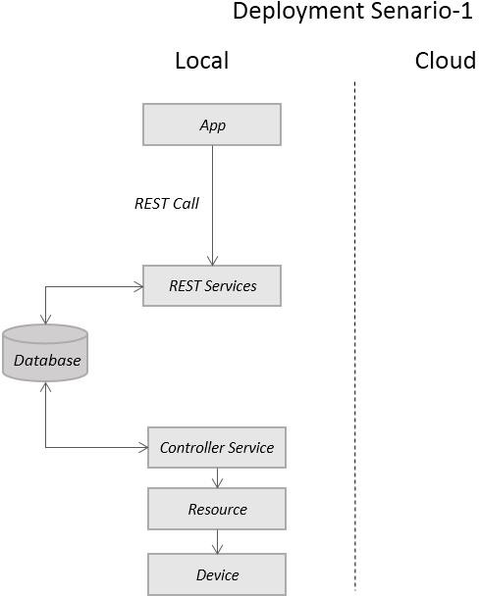
Finally - Integrate the System
Setup the device
Deploy and run the REST and Native services
Deploy and run the Application
Setup the database
Django Application
REST services implemented with Django-REST framework
SQLite Database
Native service implemented in Python OS running on Raspberry Pi
Raspberry Pi device to which sensors and actuators are connected

